Slide 1
What is Deviance?
“It is not the act itself, but the reactions to the act, that make something deviant.”
Howard Becker, 1966

Slide 2
Deviance
Sociologically – any violation of norms (but we know that what is considered deviant to some is not to others)
  Sociologists search outside the individual
    Crime is a violation of norms written into law, and each society has its own laws against certain types of behavior
    Social influences-such as socialization, group membership may influence some people to break norms

Slide 3
Deviance terminology
Deviance- violation of rules or norms
Crime- violation of norms that have been written into laws
Stigma- blemish on normal identity

Slide 4
What is Deviance?
Relative Deviance
What is Deviant to Some is not Deviant to Others
“Deviance” is Nonjudgmental Term

Slide 5
Sociological interest
The social deviance that interests sociologists the most concerns offenses that are seriously disapproved by many people and therefore evoke serious social consequences for the violators.

Slide 6
Norms Make Social Life Possible
Makes Behavior Predictable
No Norms - Social Chaos
Social Control
  Group’s Formal and Informal Means of Enforcing Norms

Slide 7
Sanctions
Negative Sanctions
Positive Sanctions

Slide 8
Explanations of Deviance
Sociobiology
Look for Answers Inside Individuals
Genetic Predispositions

Slide 9
Explanations of Deviance
Psychology
Focuses on Abnormalities Within Individuals
Personality Disorders
Deviant Personalities

Slide 10
Explanations of Deviance
Sociology
Look for Answers Outside Individuals
  Socialization
  Membership in Subcultures
Social Class

Slide 11
everybody
To sociologists everybody is deviant, whether you have committed murder or you have jaywalked everyone has violated a rule at one time or another
  This brings us back to Goffman and stigma and Master status

Slide 12
Symbolic Interactionist Perspective Differential Association Theory
Families
Friends, Neighbors
Subcultures
Prison or Freedom?

Slide 13
Symbolic Interactionist Perspective Control Theory
Inner Controls
Morality
Conscience
Religious Principles

Slide 14
Symbolic Interactionist Perspective Control Theory
Outer Controls
Attachments
Commitments
Involvements
Beliefs that Actions are Morally Wrong

Slide 15
Symbolic Interactionist Perspective Labeling Theory
Focuses on the Significance of Labels
Labels Become Part of Self-Concept
Propel Towards or Away from Deviance

Slide 16
Symbolic Interactionist Perspective Rejecting Labels
Denial of Responsibility
Denial of Injury
Denial of a Victim

Slide 17
Symbolic Interactionist Perspective Rejecting Labels
Condemnation of Condemners
Appeal to Higher Loyalties

Slide 18
Symbolic Interactionist Perspective Labeling Theory
Embracing Labels - Outlaw Bikers
The Power of Labels - Saints and Roughnecks

Slide 19
Functionalist Perspective
Can Deviance Be Functional?
Clarifies Moral Boundaries and Affirms Norms
Promotes Social Unity
Promotes Social Change

Slide 20
Functionalist Perspective
Strain Theory
Cultural Goals
Institutional Means
Strain Leads to Anomie

Slide 21
Functionalist Perspective
Four Deviant Paths
Innovators
Ritualism
Retreatism
Rebellion

Slide 23
Functionalist Perspective
Illegitimate Opportunity Structures
Social Class Produces Distinct Styles of Crime
Street Crime
White-Collar Crime
  Corporations as Criminals
Gender and Crime

Slide 24
Source: By the author. Based on Statistical Abstract of the United States 2009: Table 297.

Slide 26
The Conflict Perspective
Class, Crime, and the Criminal Justice System
Power and Inequality
The Law as an Instrument of Oppression

Slide 27
Reaction to Deviance
Street Crime and Prisons

Slide 28
Violent Crime defined
Murder – the willful (non-negligent) killing of one human being by another.
Is the least common of violent crimes
Male killing male
Young and of minority status
Women- husband or boyfriend
Men and strangers

Slide 29
Violent Crime defined
Forcible Rape – the carnal knowledge of a female body against her will.
Sexual penetration
Force or threat of
Non-consent of victim

Slide 30
Rape
More likely to occur in warm weather months.
  People are outside more and later
  Doors are open
  Windows are unlocked

Slide 31
Violent Crime defined
Robbery – the taking or attempting to take anything of value from the care, custody, or control of a person or persons by force or threat of force or violence and/or putting the victim in fear.
  Young adults with a gun

Slide 32
Violent Crime defined
Aggravated Assault – an unlawful attack by one person upon another for the purpose of inflicting severe or aggravated bodily injury. This type of assault is usually accompanied by the use of a weapon or by means likely to produce death or great bodily harm.

Slide 33
Property Crime defined
Burglary – breaking or entering- the unlawful entry of a structure to commit a felony or a theft. Attempting forcible entry is included.

Slide 34
Property Crime defined
Larceny-theft – the unlawful taking, carrying or riding away of property from the possession of another (shoplifting, pick-pocketing or the taking of any property of article which is not taken by force, violence or fraud).

Slide 35
Property crime defined
Motor Vehicle Theft – the theft or the attempted theft of a motor vehicle. A motor vehicle is self propelled and runs on the surface and not on rails. Specifically exclude are motorboats, construction equipment, airplanes, and farming equipment.

Slide 36
FBI Crime Clock
LETS TAKE A LOOK

Slide 37
Prisons
Over crowded
Race-ethnicity- over represented
Young
Single
Males
No education

Slide 39
Source: By the author. Based on Statistical Abstract of the United States 1995: Table 349; 2009: Table 333. The broken line is the author’s estimate.

Slide 41
Serial murder
Defined as someone who murders at least three persons in more than a 30-day period. These killings typically involve one victim per episode

Slide 42
Serial murder
5 phases
Fantasy
Stalk
Abduction
Kill
disposal

Slide 43
Serial murder
35+ serial murders roaming our streets
Becoming a victim may very well depend on nothing more than being in the wrong place at the wrong time
  However, a person in the United States is as likely to be struck and killed by lightning as to do die at the hands of a serial murderer.

Slide 44
Mass murder
The killing of a number of persons at one time in one place
  4 components
  The number of victims
  The location of the murders
  The time period in which the killings are carried out
  The distance from one murder site to another

Slide 45
Mass vs. Serial murder
Mass murderers often die at the scene
Serial killers avoid detection
Mass murder the impact is immediate, but short lived
Serial murder can disrupt for long periods of time
Mass murder are often perceived to be mentally ill

Slide 46
Hate crimes
This is a crime that is motivated by bias (dislike, hatred) against some-one’s race-ethnicity, religion, sexual orientation, disability, or national origin
Skin head terminology from murder in America

Slide 47
Hate crimes
Directed against
Race-ethnicity
African Americans
Whites
Latinos
Asian Americans
Native Americans
Number of victims
3,076
910
639
280
72

Slide 48
Hate crimes
Directed against
Religion
Jews
Muslims
Catholics
Protestants
Number of victims
1,084
174
71
58

Slide 49
Hate crimes
Directed against
Sexual Orientation
Male Homosexual
Female Homosexual
Homosexuals (general)
Heterosexuals
Bisexuals
Number of Victims
984
221
267
26
15

Slide 50
Hate crimes
Directed against
Disabilities
Mental
Physical
Number of victims
30
20

Slide 51
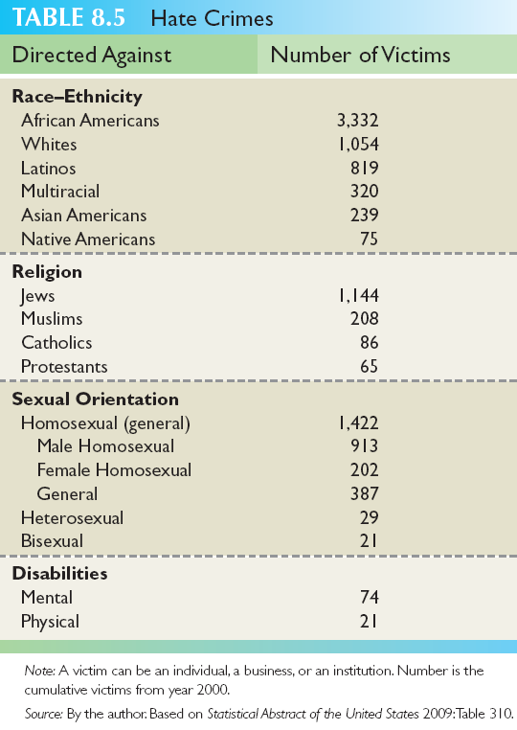

Slide 52
3 strikes law
Statutes enacted by the state governments in the United States which require the state to hand down a mandatory and extended period of incarceration
persons who have been convicted of a serious criminal offense on three or more separate occasions---Habitual offender

Slide 53
3 strikes law
Habitual offender
  The rational for these laws is that the automatic and lengthy imprisonment of individuals who commit 3 or more felonies is justified on the basis that recidivists are incorrigible (bad beyond correction or reform) and chronically criminal, and must be imprisoned as a matter of public safety.

Slide 54
A third felony conviction
Brings a sentence of life in prison, with no parole possible until a long period of time, most commonly twenty five years, has been served.

Slide 55
Violent crimes
Some states require all 3 felony convictions to be for violent crimes in order for the mandatory sentence to be pronounced
  California however mandates the enhanced sentence for any third felony conviction, so long as the first 2 felonies were deemed to be either violent or serious or both

Slide 56
Functionalist perspective
Unintended consequences
  California punishes shoplifting and similar crimes as felony petty theft if the person who committed the crime has a prior conviction for any form of theft, including robbery or burglary.
As a result, some defendants have been given sentences of 25 years to life in prison for such crimes as shoplifting golf clubs

Slide 57
Unintended consequences
The systems healthcare system inadequate and inhumane by federal.
causing aging of the prison population

Slide 58
Criticism
Since a criminal on his or her third strike stands to receive the maximum penalty allowable (perhaps barring the death penalty), there can be a perverse incentive to murder witnesses or police officers to escape capture

Slide 59
Criticism
Life sentences rule out the possibility of rehabilitation
remove prisoner incentives to participate in prison programs
control their behavior, producing a larger population of violent and disruptive prisoners.

Slide 60
Criticisms
Increase the number of inmates
Housing capacity
Maximum security prisons

Slide 61
Reaction to Deviance
Street Crime and Prisons
The Decline of Crime
Recidivism
The Death Penalty Bias

Slide 62
Death penalty
Retentionist countries – countries that use the death penalty

Slide 63
Capital punishment
The execution of a person by the state as punishment for a crime
  Premeditated murder
  Espionage
  Treason
  Sexual crimes
  Cowardice
  Desertion
  Mutiny- rebellion against any authority.

Slide 64
A capital crime originally was to be punished by the loss of the head.
  Decapitation
  Electrocution
  Firing squad
  Gas chamber
  Hanging
  Lethal injection
  Shooting

Slide 65
Most executions carried out in 2007
Country Number
China 470+
Iran 317+
Saudi Arabia 143+
Pakistan 135+
USA 42
Iraq 33+

Slide 66
Supporters
Deters crime
Prevents recidivism
Less expensive
Appropriate form of punishment

Slide 67
Opponents
Wrongfully convicted
Discriminates against poor and minority
Does not deter
“culture of violence”

Slide 68
20th century
For most of recorded history, capital punishments were often cruel and unusual.
Bloodiest of human history
Trends in most of the world have long been to move to less painful or humane executions

Slide 69
U.S. Surveys
Majority in favor of capitol punishment
  July 2006- 65% in favor
  50% say it is not enacted enough
  60% believe it is applied fairly

Slide 70
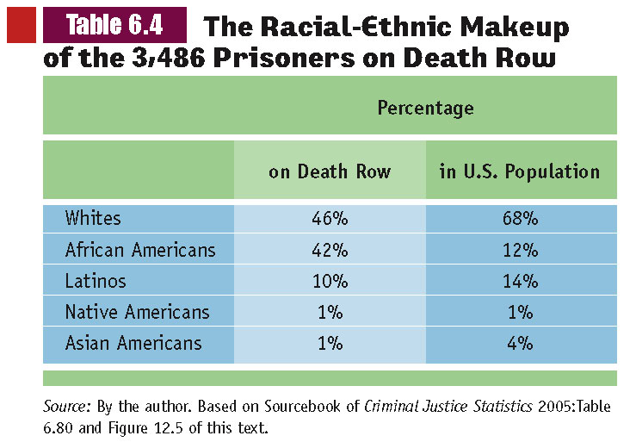

Slide 71
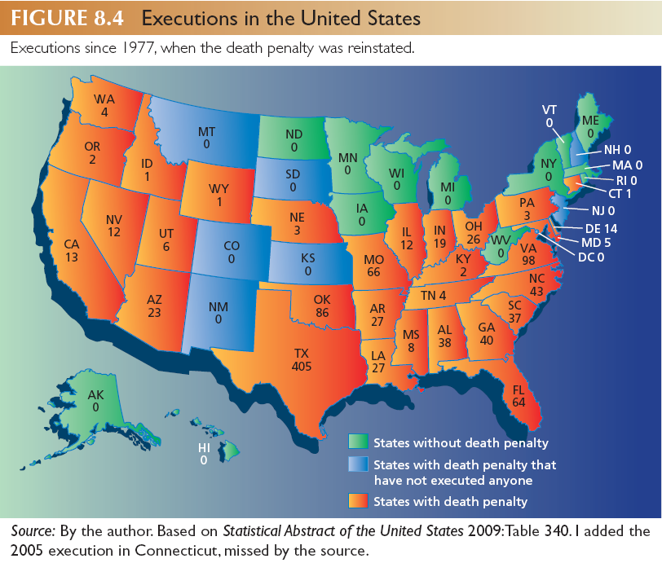

Slide 72
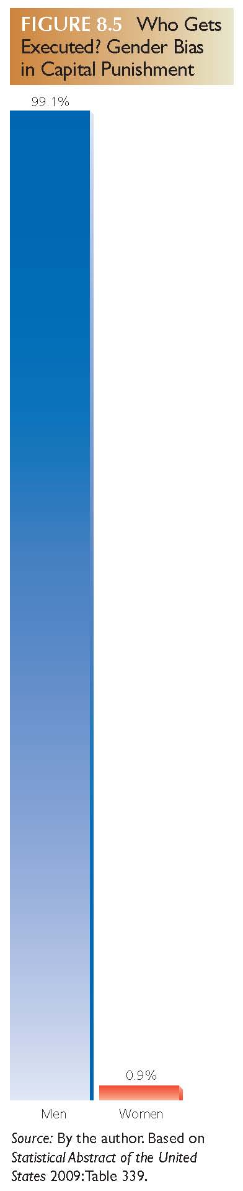

Slide 73
Reaction to Deviance
Medicalization of Deviance
  Neither Mental nor Illness?
  Homeless Mentally Ill
Need for More Humane Approach
Legal Change
  Hate Crimes
Trouble with Statistics

Slide 74
Collective behavior
Sociologists view collective behavior as the actions of ordinary people who are responding to extraordinary situations

Slide 75
Collective Behavior: Early Explanations
Robert Park and Ernest Burgess first used the term “collective behavior” in ‘Introduction to the Science of Sociology’ in 1921

Slide 76
Collective Behavior: Early Explanations
The Transformation of the Individual
How the Crowd Transforms the Individual
Robert ParkS
  Circular Reaction

Slide 77
Collective Behavior: Early Explanations
Robert Park- U.S. Sociologist
  Social unrest… is transmitted from one individual to another
  Circular Reaction- refers to this back and forth communication
    it creates a collective impulse that dominates all members of a crowd; like LeBon’s collectve mind

Slide 78
Collective Behavior
The Acting Crowd - Five Stages
Tension or Unrest
Exciting Event
Milling Behavior
Common Object
Common Impulses

Slide 79
Herbert Blumer
The most advanced version of contagion theory
  Five stage process
  Confusing situation- social unrest, people are disturbed about some condition of society, people become apprehensive which makes them vulnerable to rumors and suggestions
  Exciting event- this causes tension among the crowd and people become extremely sensitive and responsive to each other

Slide 80
Herbert Blumer
Milling- people are walking around, talking about the exciting event.
A common object of attention- people’s attention becomes riveted on some aspect of the event
  They get caught up in the collective excitement
Common impulses- are stimulated by social contagion, a sense of excitement that is passed from one to another
  This makes it possible for the acting crowd to unite with purpose

Slide 81
Herbert Blumer
Introduced the concept of the Mass
  It is composed of anonymous individuals who do not interact with one another
  They act to an object that has gained their attention
    People who closely follow a murder trial on television
      It is the common focus of attention that makes the group a mass

Slide 82
Herbert Blumer
In crowds, milling and contagion effectively eliminate independent thought among members
  People engage in behaviors they normally would not
In masses, the interpretation of some event produces collective action

Slide 83
Social contagion theory
Evaluation
  It is no longer used in modern collective behavior research
  In the end, sociologists relying on contagion theory are forced to conclude that participants lost their ability to reason and research has failed to support this assertion

Slide 85
Contemporary View: The Rationality of the Crowd
The Minimax Strategy
Emergent Norms-Five Kinds of Participants
  The Ego-Involved
  The Concerned
  The Insecure
  The Curious Spectators
  The Exploiters

Slide 86
Emergent norm process
Crowds have 5 kinds of participants
The ego-involved feel a personal stake in the unusual event
The concerned- also have a personal interest in the event, but less so than the ego involved
The insecure- care little about the matter; they join the crowd because it gives them a sense of power, security and belonging

Slide 87
Emergent norm process
Crowds have 5 kinds of participants
The curious spectators- also care little about the issue; the issue they are simply curious about what is going on
The exploiters- don’t care about the event; they use it for their own purposes, such as hawking food or T-shirts.

Slide 88
Analysis
The key to ENP is confusion or uncertainty
People must be convinced that the situation makes normal behavior inappropriate
Confusion creates doubt and doubt makes people likely to follow others who seem to know what they are doing

Slide 89
Settings of collective behavior
Acting crowds
  Do something
    Lynching’s
    Revolutions
    Violent demonstrations
    Mass lootings

Slide 90
1930 Shipp and Abram Smith
  They had been arrested the night before, charged with robbing and murdering a white factory worker and raping his girlfriend. A large crowd broke into the jail with sledgehammers, beat the two men, and hanged them. Police officers in the crowd cooperated in the lynching.

Slide 91
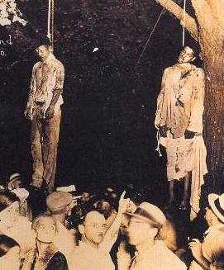
1930 Shipp and Abram Smith

Slide 92
1919 William Brown
Douglas County, Nebraska
Will Brown is lynched, and his body mutilated and burned by a white crowd
"The judge says he will give up Negro Brown. He is in dungeon. There are 100 white prisoners on the roof. Save them."
Sheriff Clark said that Negro prisoners hurled Brown into the hands of the mob as its leaders approached the stairway leading to the county jail.

Slide 93
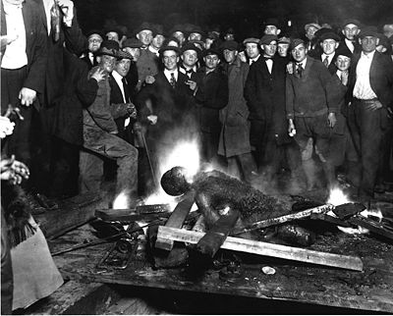
1919 William Brown

Slide 94
Rubin Stacey, 1935 Ft. Lauderdale
Six deputies were escorting Stacy to Dade County jail in Miami on 19th July, 1935, when he was taken by a white mob and hanged by the side of the home of Marion Jones
Stacy, a homeless tenant farmer, had gone to the house to ask for food; the woman became frightened and screamed when she saw Stacy's face."

Slide 95
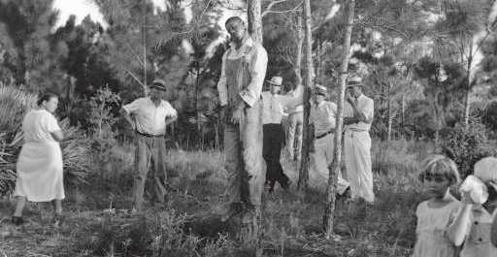
Rubin Stacey, 1935 Ft. Lauderdale

Slide 96
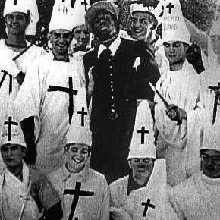
1977 Citadel year book

Slide 97
Forms of Collective Behavior
Riots
Background Conditions
Precipitating Event
General Context

Slide 98
Forms of collective behavior
Riots-violent crowd behavior directed at people and property
  an offense against the public peace and good order
  three or more persons to be involved
  The event that precipitates the riot is important, but so is the riot’s general context
    Deadly riots we will discuss in depth later
      The Los Angeles Riot of 1992

Slide 99
Riots
A sudden outbreak of collective behavior and are more generalized than mob violence.
They do not have to be deadly or violent
  Celebration riots
  Involve the destruction of property but the participants do not intentionally hurt each other

Slide 100
Sports celebration riots
Usually occur when a local team wins a major professional championship
  Becoming so common that the behavior is an expected ritual following any major sporting event

Slide 101
Sports celebration riots
Examples of wild enthusiasm and extreme excitement
Participants smash, trample and knock things down to express their excitement

Slide 102
Forms of collective behavior
Riots-violent crowd behavior directed at people and property
  an offense against the public peace and good order
  three or more persons to be involved
  The event that precipitates the riot is important, but so is the riot’s general context
    Deadly riots we will discuss in depth later
      The Los Angeles Riot of 1992

Slide 103
Forms of Collective Behavior
Rumors
Short-Lived
Thrive on Ambiguity or Uncertainty
Of Little Consequence
Pass from Person to Person

Slide 104
Forms of collective behavior
Rumors-
  Unverified information about some topic of interest passed from one person to another
  They thrive on uncertainty and fear
  Short lived and most are of little consequence

Slide 105
Forms of collective behavior
Rumors have been called the lowest, or most basic form of collective behavior
Although rumors tend to change over time , many people still believe that they are true even when there is evidence to change their minds
  McDonald’s worm burgers

Slide 106
Forms of Collective Behavior
Panics and Mass Hysteria
The Classic Panic
The Occurrence of Panics
Not Everyone Panics

Slide 107
Forms of collective behavior
Panics
  People become so fearful that they cannot function normally and may flee a situation they see as threatening
    Financial panic- stock market crashing

Slide 108
Forms of collective behavior
Moral panics
  Occur when large numbers of people become concerned, even fearful, about some behavior that they believe threatens morality
    Center on a sense of danger
    Thrive on uncertainty, fear and anxiety
      Stranger kidnappings and satanic cults

Slide 109
Forms of collective behavior
Mass hysteria
  An imagined threat causes physical symptoms among large numbers of people
    Nausea, dizziness, fainting
    Participants make themselves sick with worry over rumors
      Food poisoning
      Poisonous bugs

Slide 110
Forms of Collective Behavior
Mass Hysteria
Moral Panics
Fads and Fashions
Urban Legends

Slide 111
Fads
Occur whenever large numbers of people enthusiastically embrace some pattern of behavior
These participants want to do or buy whatever it is because everybody else is

Slide 112
Forms of collective behavior
Fads
  Appears suddenly and spread by imitation
    Food and diet fads
    Child rearing fads
    Toy fads

Slide 113
Forms of collective behavior
Fashion-
  This happens when a fad last
  Clothing
  Furniture
  Hairstyles
  Common expressions

Slide 114
Forms of collective behavior
Urban legends
  Stories with an ironic twist that sound realistic but are false.

Slide 115
Is collective behavior really “odd”?
There is an important difference in calling an episode “violent and terrible” and calling the participants “violent and terrible”
  Most collective behavior theories start with the assumption that participants are normal people
  All of them recognize that the behavior would not have occurred under different circumstances

Slide 116
Social movements
When a group of people organize to attempt to encourage or resist some type of social change
People with little or no political power join together in order to acquire some
A social movement is rarely represented by just one organization.
  A movement includes any individuals or groups working toward some common goal

Slide 117
Social movements
Make it possible for citizens to change policies created by elected officials that do not follow their own oaths
Some social movements are trying to better society while others try to oppress and exclude
What all social movements have in common though is the desire by ordinary citizens to have a say in the operation of their society

Slide 118
Social movements
Some sociologists call social movements “collective action” instead of “collective behavior”.
  They argue that social movements really aren’t the same as other kinds of collective behavior
  Others call them a form of collective behavior.
    The similarities out weigh the differences

Slide 119
Tactics of Social Movements
Levels of Membership
The Inner Core
The Committed
The Less Committed

Slide 120
Social Movements
Proactive Social Movements
Reactive Social Movements
Social Movement Organizations

Slide 121
Tactics of Social Movements
The Publics
Sympathetic Public
Hostile Public
Disinterested People

Slide 122
Tactics of Social Movements
Levels of Membership
The Inner Core
The Committed
The Less Committed

Slide 123
Tactics of Social Movements
The Publics
Sympathetic Public
Hostile Public
Disinterested People

Slide 125
Tactics of Social Movements
Relationship to Authorities
Peaceful
Violent

Slide 126
Propaganda and the Mass Media
Propaganda Defined
Techniques of Propaganda
  Name-Calling
  Glittering Generality
  Transfer
  Testimonials

Slide 127
Propaganda and the Mass Media
Techniques of Propaganda
  Plain Folks
  Card Stacking
  Bandwagon

Slide 128
What is Gender Stratification?
“males’ and females’ unequal access to property, power, and prestige.”

Slide 129
Issues of Sex and Gender
Sex – Biological Characteristics
Female and Male
Primary and Secondary Sexual Characteristics

Slide 130
Issues of Sex and Gender
Gender - Social Characteristics
Masculinity and Femininity
Appropriate Behavior

Slide 131
Gender Differences In Behavior Biology or Culture?
Dominant Position in Sociology
Social Factors Primary, Not Biological
If Biological Should Be Less Variation

Slide 132
Gender and Inequality in Global Perspective
How Females became a Minority Group
The Origins of Patriarchy
Sex Typing of Work
Gender and Prestige of Work

Slide 133
Gender and Inequality in Global Perspective
Other Areas of Global Discrimination
Global Gap in Education
Global Gap in Politics
Global Gap in Pay
Violence Against Women

Slide 134
Social construction of gender
Understanding this through the eyes of a sociologist; watch people the next time you are out
  How do adults treat young boys and girls different
  How are children’s products packaged

Slide 135
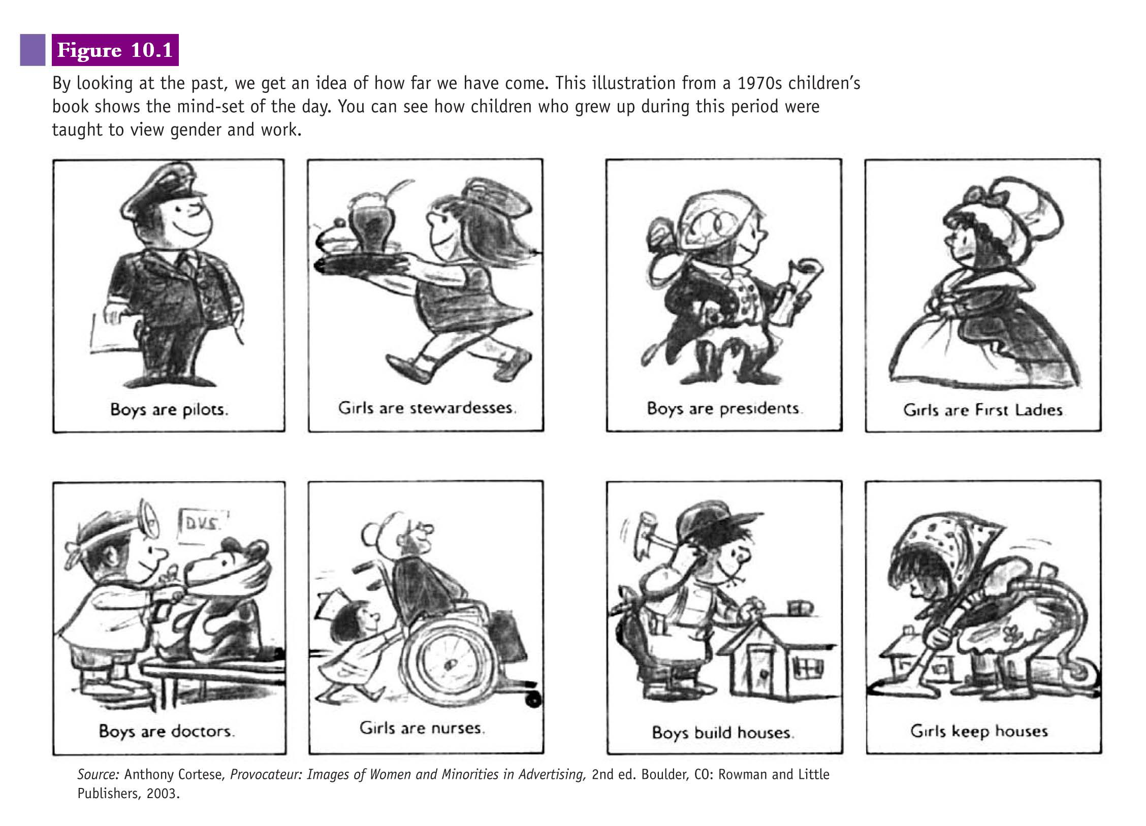

Slide 137
Snopes article

Slide 138
Gender Inequality in the U.S.
Fighting Back: The Rise of…
Feminism
First Wave—Early 1900s
Second Wave Began 1960s
Third Wave Has Emerged

Slide 139
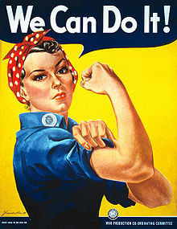

Slide 140
Sexism
Female sexism- the entire range of attitudes, beliefs, policies, and behaviors against women on the basis of their gender

Slide 141
Gender inequality in the United States
Conflict theory- power yields prestige
Feminism
  Biology is not destiny
  Stratification by gender should be resisted

Slide 142
Sexism and employment
In 2007- women earned .77 cents to a man’s dollar (U.S. Census Bureau)
Despite 3 decades of policy change, women and minorities are still blocked from senior management positions

Slide 143
Gender Inequality in the Workplace
The Pay Gap

Slide 144
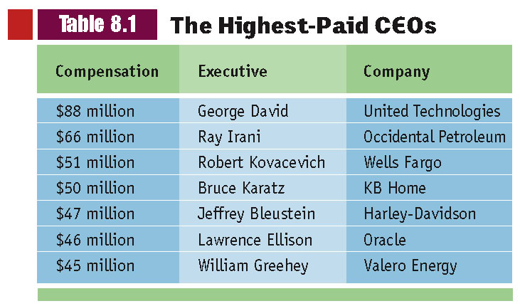

Slide 145
40% women
Below are the five more prevalent occupations for women who worked full time during year 2006.
Secretaries and administrative assistants
Registered nurses
Cashiers
Elementary and middle school teachers
Retail salespersons

Slide 146
factoids
Women are concentrated in lower paying occupations
Women enter the labor force at different and lower paying levels vs. men
Women as a group have less education and experience compared to men and are therefore paid less
Women work less overtime next to men

Slide 147
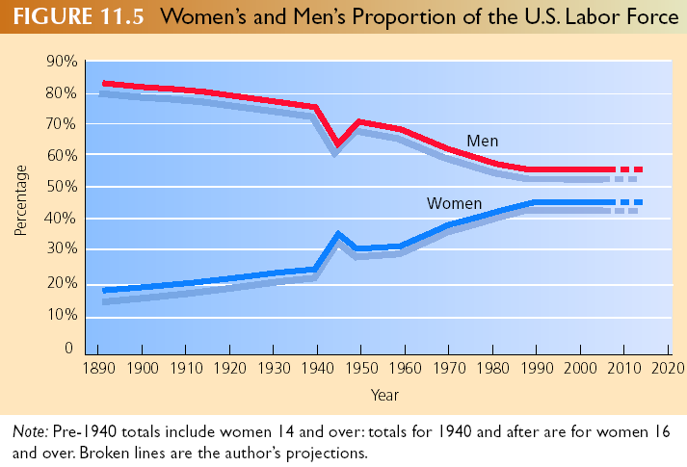

Slide 148
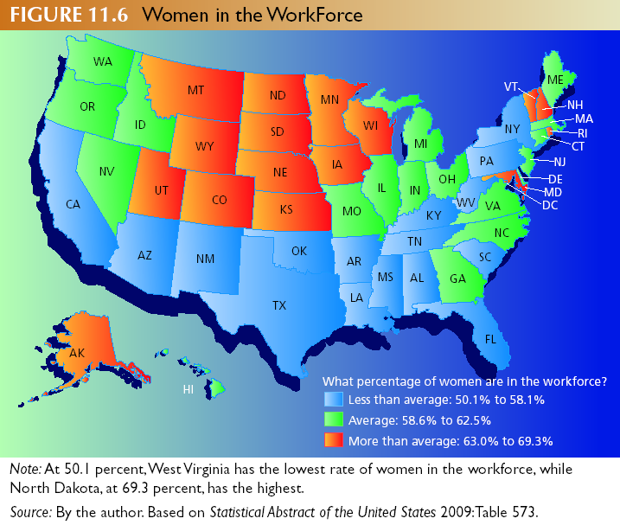

Slide 149
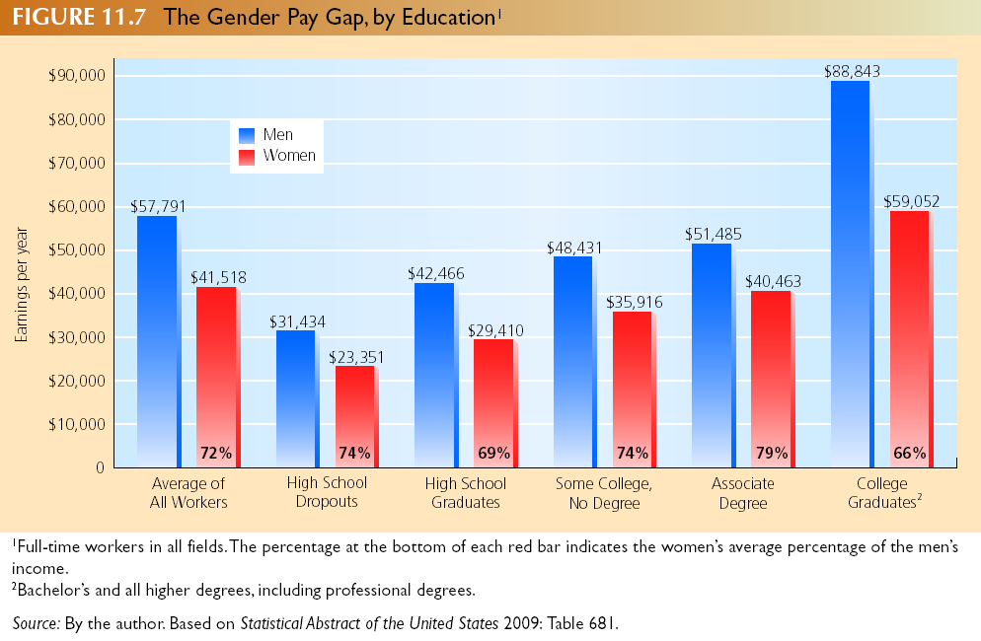

Slide 150
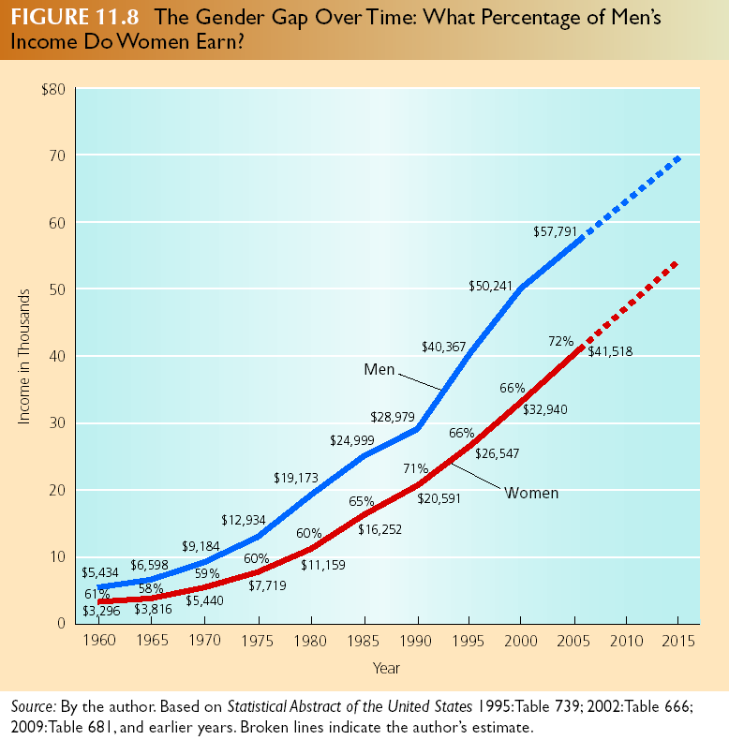

Slide 151
Gender Inequality in the Workplace
Sexual Harassment and Worse
The Pay Gap
The Cracking Glass Ceiling

Slide 152
Sexual harassment
The most persistent and difficult aspects of sexism

Slide 153
Sexual harassment
  Includes continual or repeated verbal abuse of a sexual nature, including but not limited to graphic commentaries on the victims body, sexually suggestive objects or postures in the work place, sexually degrading words used to describe the victim or propositions of a sexual nature.

Slide 154
Sexual harassment
Includes the threat or insinuation that lack of sexual submission will adversely affect the victim’s employment, wages, standing, or other conditions that affect the victims livelihood.

Slide 155
Gender Inequality in the U.S.
Gender Inequality in Daily Life
Devaluation of the Feminine
The Feminine as Insult

Slide 156
Gender Inequality in the U.S.
Gender Inequality in Health Care
Gender Inequality in Education

Slide 157
Socialization and education
Gender influence within the education system
  Boys are often called on more
  Gendered to groups to play
  Boys seem to be the center of attention; for both positive and negative consequences

Slide 158
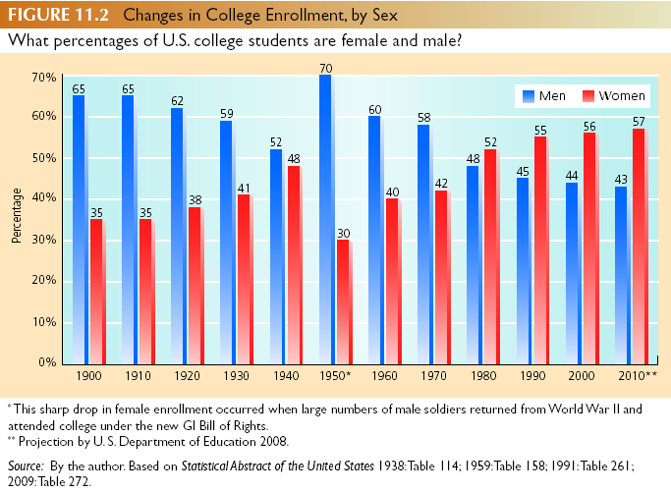

Slide 159
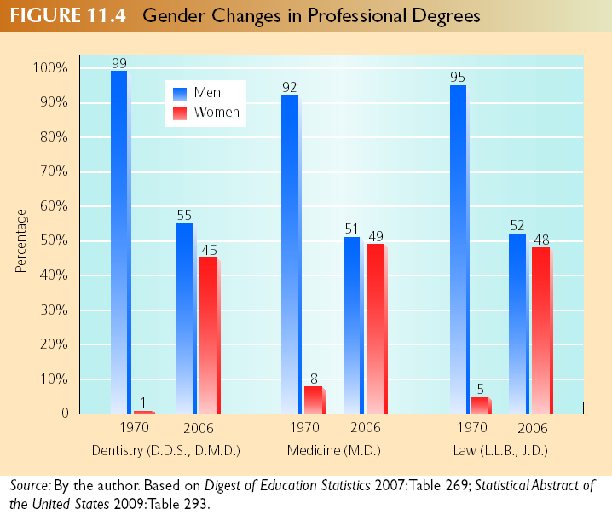

Slide 160
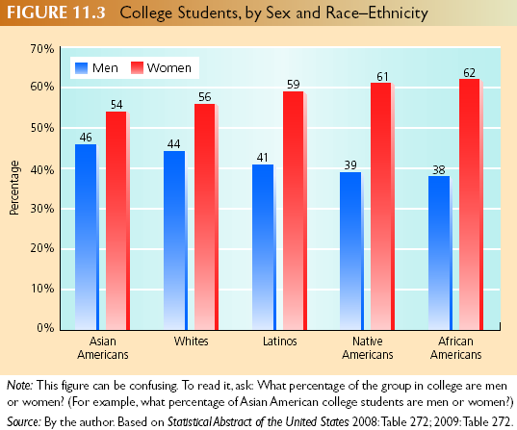

Slide 162
Gender and Violence
Violence Against Women
Forcible Rape
Date (Acquaintance) Rape
Murder
Violence in the Home

Slide 163
Gender and violence
Most victims of violence are females
Each year almost 3 in every 1,000 American women aged 12 and older are raped
Battering, spousal abuse, incest, and female circumcision

Slide 164
Fact’s about battering

Slide 165
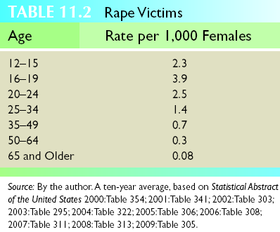
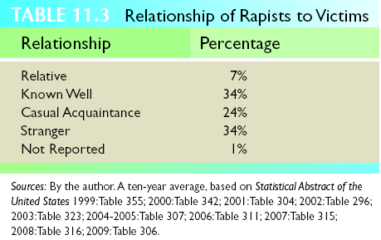

Slide 166
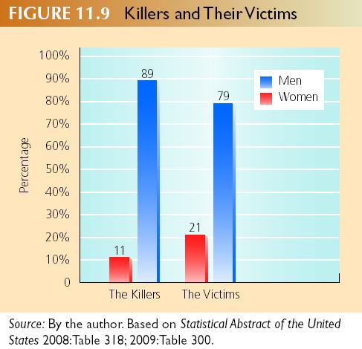

Slide 167
Gender and Violence
Feminism and Gendered Violence
  Symbolic Interactionists
    Association of Strength, Virility, and Violence
  Conflict Theory
    Men Losing Power, Reassert Through Violence
Solutions

Slide 168
Solutions
No magic bullet
Breaking the connection with masculinity and violence
  Educational programs
    Schools
    Churches
    Homes
    The media

Slide 169
Changing face of politics
Women are less likely to have a supportive spouse
Men reluctant to incorporate women in the decision making process

Slide 170
Changing Face of Politics
Women Majority in Population
Women Underrepresented in Government
Women Underrepresented in Law and Business Careers

Slide 171
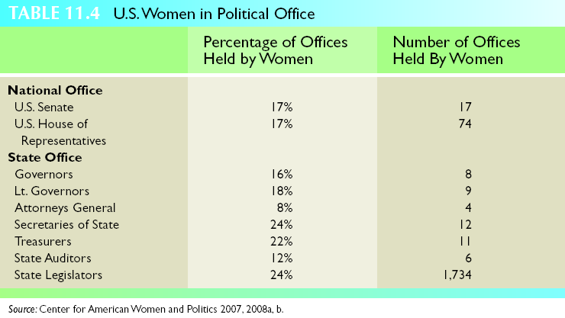

Slide 172
Glimpsing the Future - With Hope
Barriers Coming Down
Activities Degendered
New Consciousness

Slide 173
A woman should have

Slide 174
Race: Myth and Reality
Myth 1 - Idea That Any Race is Superior
  All Races Have Geniuses and Idiots
  Genocide Still Around
Myth 2 - Idea that Any Race is Pure
  Human Characteristics Flow Endlessly Together

Slide 175
Ethnic Groups
Race Refers to Biological Characteristics
Ethnicity Refers to Cultural Characteristics
  Common Ancestry
  Cultural Heritage
  Nations of Origin

Slide 176
Minority and Dominant Groups
Minority Group - People Singled Out for Unequal Treatment
Minority Group Not Necessarily Numerical Minority

Slide 177
Minority and Dominant Groups
Dominant Group - Group with Most…
  Power
  Privileges
  Highest Social Status
Dominant Group Does the Discriminating

Slide 178
Emergence of Minority Groups
Minority Groups Occur Because of…
Expansion of Political Boundaries
Migration

Slide 179
Constructing Racial-Ethnic Identity
Sense of Ethnicity
  Relative Size
  Power
  Appearance
  Discrimination
Ethnic Work and the Melting Pot

Slide 180
Prejudice vs. Discrimination
Prejudice- attitude
Discrimination- unfair treatment

Slide 181
Learning prejudice
Learn from association
KKK
Aryan nation
The Far-Reaching Nature of Prejudice
  Eugene Hartley (1946)

Slide 182
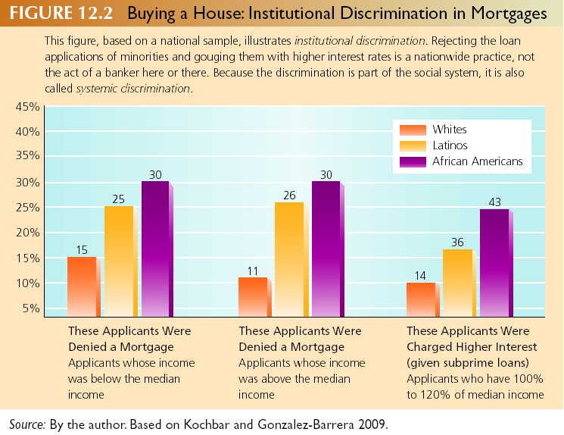
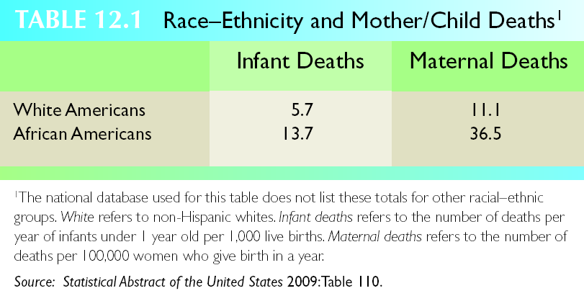
Individual and Institutional Discrimination
Home Mortgage and Car Loans
Health Care

Slide 183
Theories of Prejudice
Psychological Perspectives
Frustration and Scapegoats
The Authoritarian Personality

Slide 184
Sociological perspectives
Functionalists- social environment can create positive or negative feelings about people
Why do you think prejudice is functional?
  Creates in group and out group
Why do you think it is dysfunctional?
  Destroys human relationships

Slide 185
Theories of Prejudice
Sociological Perspectives
Functionalism
Conflict Theory
  Keep Workers Insecure
  Exploit Racial-Ethnic Divisions

Slide 186
Theories of Prejudice
Sociological Perspectives
Symbolic Interactionism
  Labels Create Prejudice
  Self-Fulfilling Prophesy

Slide 187
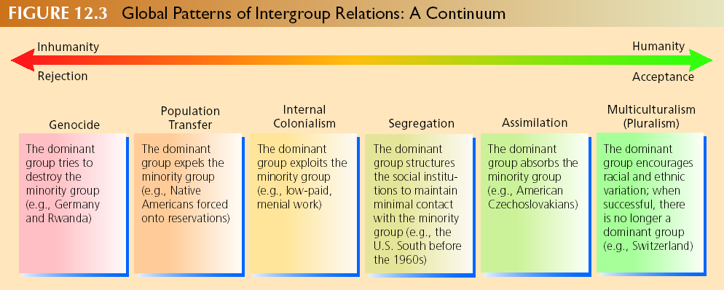
Global Patterns of Intergroup Relations
Genocide
Population Transfer
Internal Colonialism

Slide 188
Global Patterns of Intergroup Relations
Segregation
Assimilation
Multiculturalism (Pluralism)

Slide 189
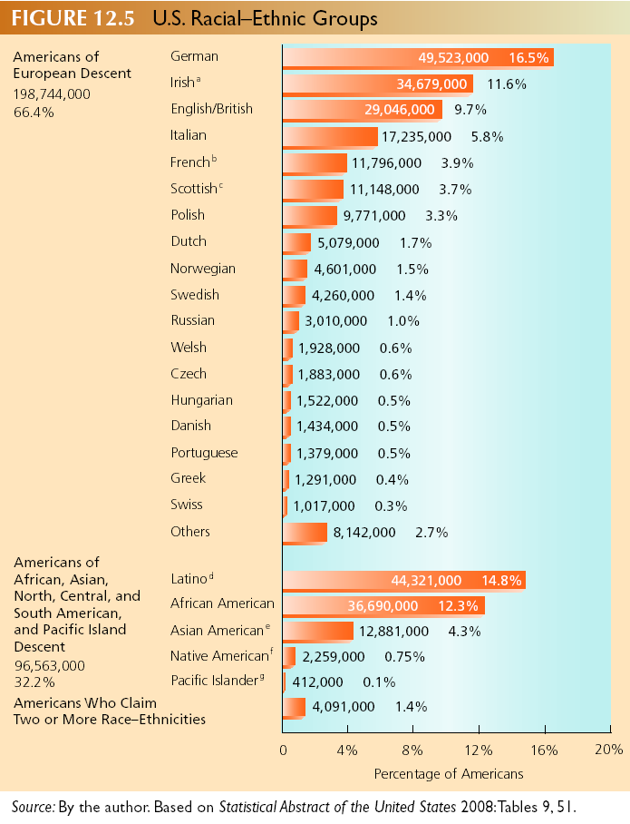
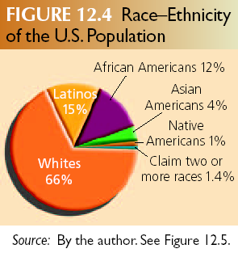
Race and Ethnic Relations in the United States

Slide 190
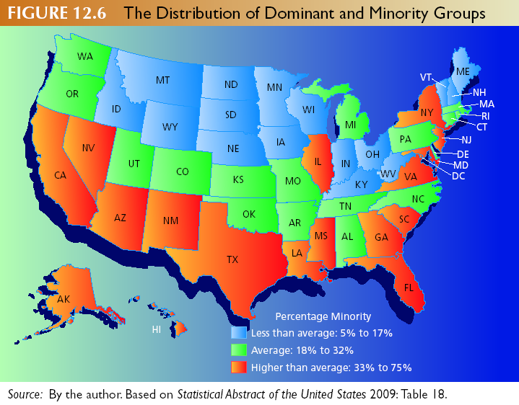
Race and Ethnic Relations in the United States

Slide 191
Global Patterns of Intergroup Relations
Genocide
Population Transfer
Internal Colonialism

Slide 192
Global Patterns of Intergroup Relations
Segregation
Assimilation
Multiculturalism (Pluralism)

Slide 193
Race and Ethnic Relations in the United States

Slide 194
Race and Ethnic Relations in the United States

Slide 195
European Americans
Nations founder’s include only those from England (WASPs)
  white Anglo-Saxon Protestants
Other “white” Europeans are inferior

Slide 196
Native Americans
Diversity of groups
  Variety of cultures and languages
From treaties to genocide and population transfer
  Standing in the way of expansion
  Reservations
The invisible minority and self determination
  Poverty, unemployment, suicide, and alcoholism

Slide 197
Race and Ethnic Relations in the United States African-Americans
The Struggle for Civil Rights
Rising Expectations and Civil Strife
Continued Gains

Slide 198
Latinos
Numbers origins, location
  Largest minority group in the United States
Spanish language
  U.S. has become one of the largest Spanish-speaking nations in the world
Diversity
  Country of origin is highly significant
Comparative conditions
  Well being and education

Slide 199
African Americans
After slavery was abolished, the Southern states passed legislation to segregate blacks and whites
1964- Civil Rights Act (eliminated discrimination based on race)
1965 – Watts Riots –caused by “Rising Expectations”
1968-Second Civil Rights Act passed
Remarkable gains have been made in politics, education, and jobs
Half of all African American families make more than $35,000 per year

Slide 200
Affirmative action
Liberals argue that this policy is the most direct way in which to level the playing field of economic opportunity
Conservatives believe that it will lead to reverse discrimination

Slide 201
Sex and Age
Master Statuses
  Significant differences in peoples lives
  Cuts across all aspects of social life

Slide 202
The graying of America
Today almost 13% of the population has achieved age 65.
  There are almost 7 million more elderly Americans than there are teenagers

Slide 203
Attitudes about aging
Socially constructed
  Depends on culture not on biology
  Symbolic interactionists emphasize that no age has any particular built in meaning
Industrialization
  Higher standard of living
  Better public health measures
  Medical technology

Slide 204
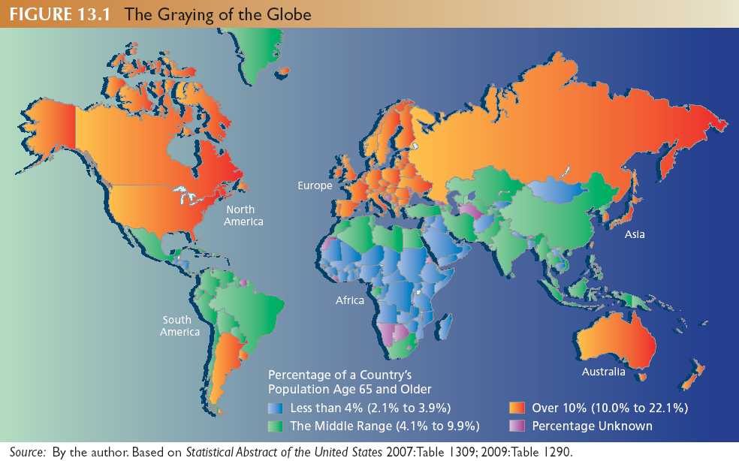

Slide 205
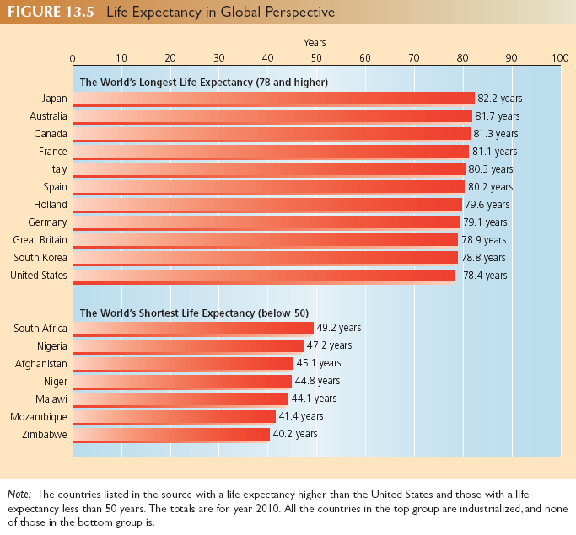

Slide 206
Aging in Global Perspective
Social Construction of Aging
  Tiwi vs. Abkhasians
Industrialization and Graying of the Globe
Graying of America
  Race, Ethnicity, and Aging

Slide 207
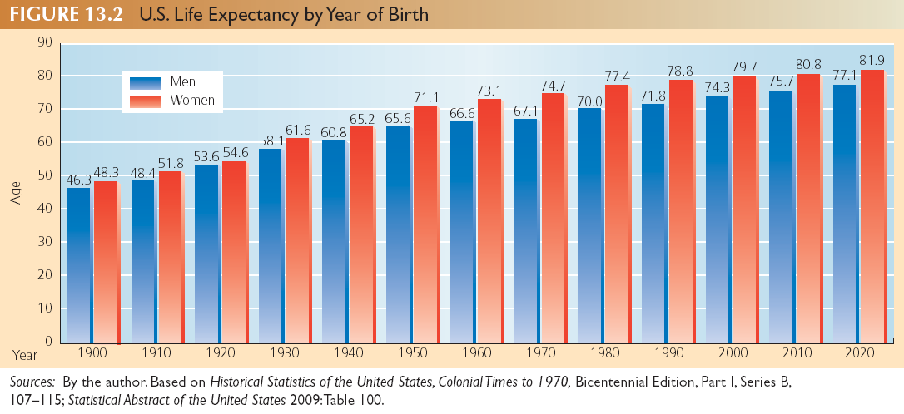

Slide 208
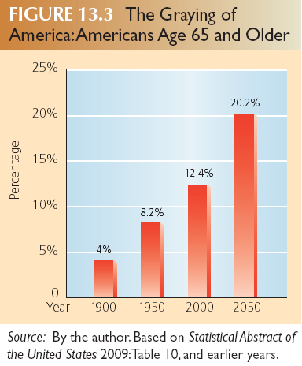
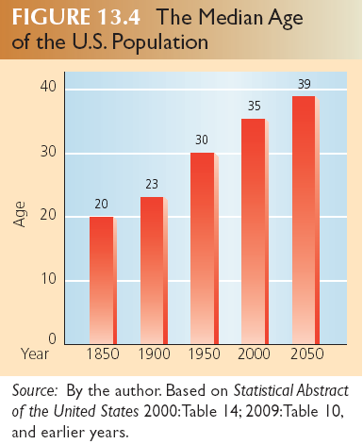

Slide 209
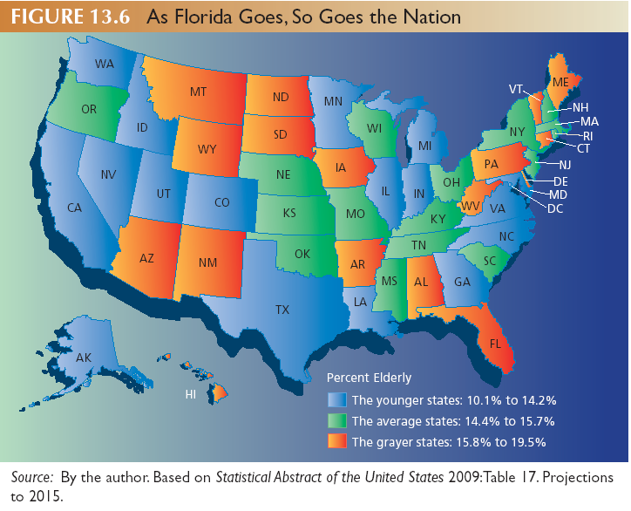

Slide 210
Symbolic interactionist perspective
Ageism- Prejudice, discrimination, and hostility directed at people because of their age
Shifting the meaning of growing old

Slide 211
Symbolic Interactionist Perspective
Deciding When You Are Old - Changing Perceptions
Biology
Personal History
Gender Age
Timetable

Slide 212
Changing Perceptions of the Elderly
Agism
Shifting Meanings
Gerotranscendence Theory
Influence of Mass Media

Slide 213
Functionalist perspective
Disengagement theory- the view that society prevents disruption by having the elderly vacate (or disengage from) their positions of responsibility so the younger generation can step into their shoes

Slide 214
Functionalist perspective
Activity theory- the view that satisfaction during old age is related to a person’s level and quality of activity

Slide 215
Functionalist perspective
Continuity theory- how people adjust to retirement by continuing aspects of their lives, such as roles or coping techniques

Slide 216
Conflict Perspective
Social Security Legislation

Slide 217
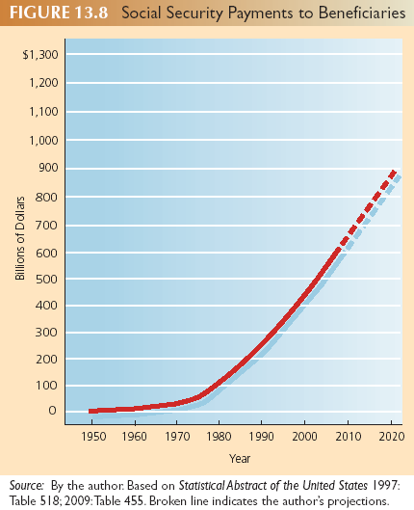

Slide 218
Conflict Perspective
Social Security Legislation
Intergenerational Conflict

Slide 219
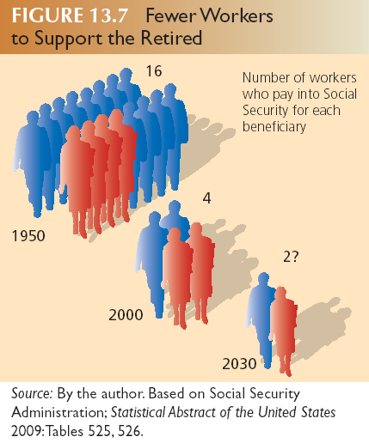

Slide 220
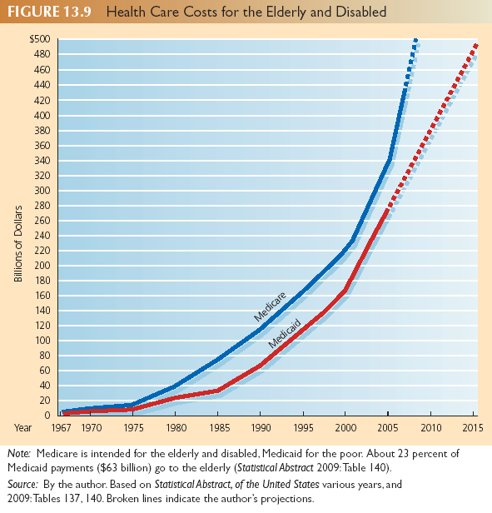

Slide 221
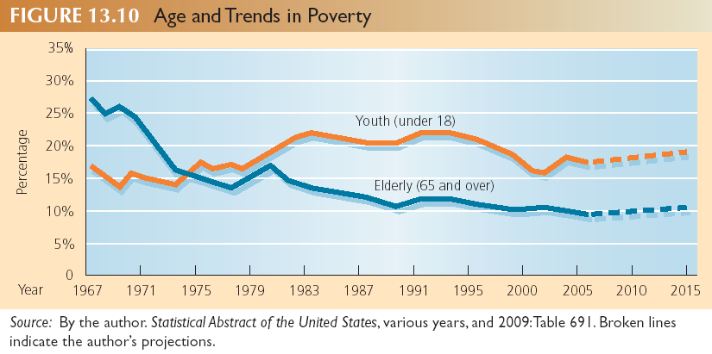

Slide 222
Conflict Perspective
Fighting Back
Gray Panthers
AARP

Slide 223
Recurring Problems
Gender and the Elderly

Slide 224
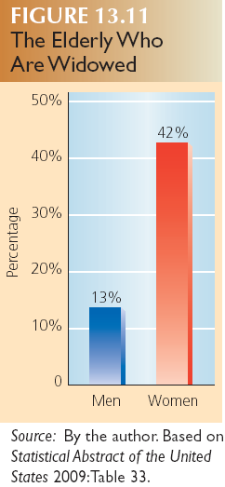
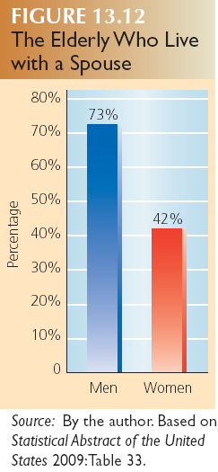

Slide 225
Problems of Dependency
Gender and the Elderly
Nursing Homes
  Understaffing, Dehumanization, and Death
  Gender Roles among Elderly

Slide 226
Problems of Dependency
Elder Abuse
Elderly Poor
  Gender and Poverty

Slide 227
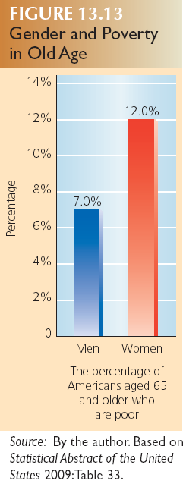

Slide 228
Problems of Dependency
Elder Abuse
Elderly Poor
  Gender and Poverty
  Race-Ethnicity and Poverty

Slide 229
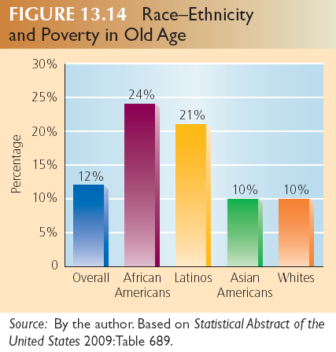

Slide 230
Sociology of Death and Dying
Industrialization and New Technology
Death as a Process
  Denial
  Anger
  Negotiation
  Depression
  Acceptance

Slide 231
Sociology of Death and Dying
Hospices
Suicide and Age
Adjusting to Death

Slide 232
A New Model of Aging
Creative Aging
Impact of Technology

Slide 233
